Slide 1
Being Here – Why?

Slide 2
“Here we are, in this galaxy, in this solar system, on this planet, in this story, around this table, at this moment – with this chance for us to breathe, think, dream, speak, and be alive together.”

Slide 3
“Here we are, in this galaxy, in this solar system, on this planet, in this story, around this table, at this moment – with this chance for us to breathe, think, dream, speak, and be alive together.”

Slide 4
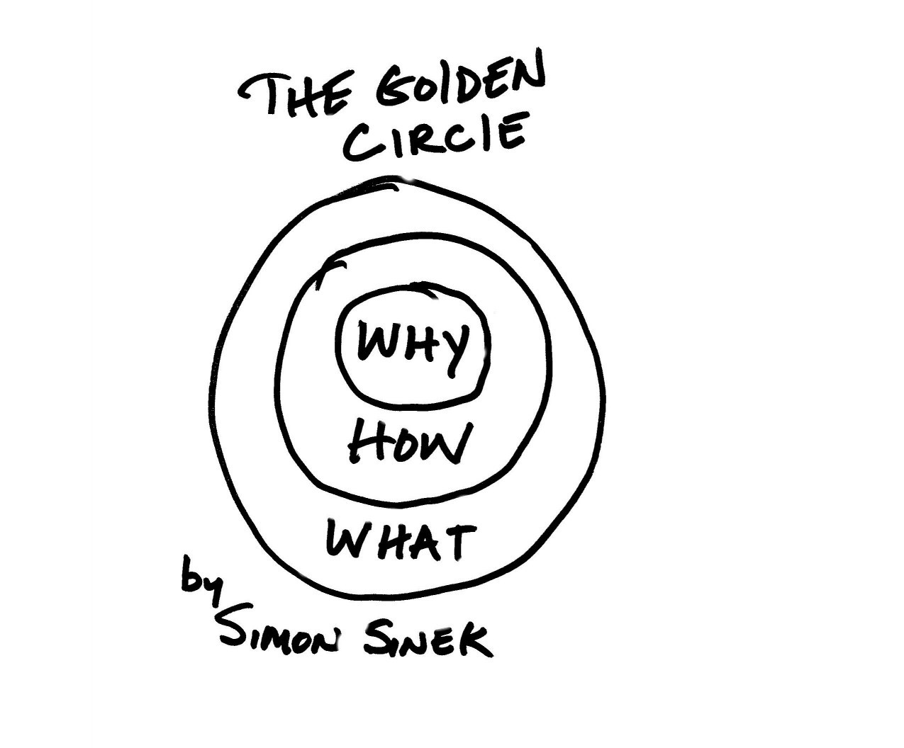

Slide 5
HOW?
God,
Bible,
Praying,
Church.
WHAT?

Slide 6
HOW?
God,
Bible,
Praying,
Church.
WHAT?

Slide 7
HOW?
God,
Bible,
Praying,
Church.
WHAT?

Slide 8
HOW?
God,
Bible,
Praying,
Church.
WHAT?

Slide 9
HOW?
God,
Bible,
Praying,
Church.
WHAT?

Slide 10
HOW?
WHY
BOTHER?
WHAT?

Slide 11
HOW?
GOD
PRAY
BIBLE
WHY?
CHURCH
WHAT?

Slide 12
What is the question which fits these answers? God Bible Pray Church

Slide 13
What is the question which fits these answers? God Bible Pray Church Why would I interact with God, Bible, Prayer or Church?

Slide 14
HOW?
GOD
Finding
the
Meaning
of Life
PRAY
BIBLE
CHURCH
WHAT?

Slide 15
HOW?
GOD
Connect
with
the
Centre
PRAY
BIBLE
CHURCH
WHAT?

Slide 16
HOW?
GOD
Discover the Essence within Existence
PRAY
BIBLE
CHURCH
WHAT?

Slide 17
HOW?
GOD
Seeking Aliveness
PRAY
BIBLE
CHURCH
WHAT?

Slide 18
HOW?
GOD
breathe, think, dream, speak and
be alive
PRAY
BIBLE
CHURCH
WHAT?

